Slide 1
FairDice: an interactive lecture hall experiment
Background information and real-world examples

Slide 2
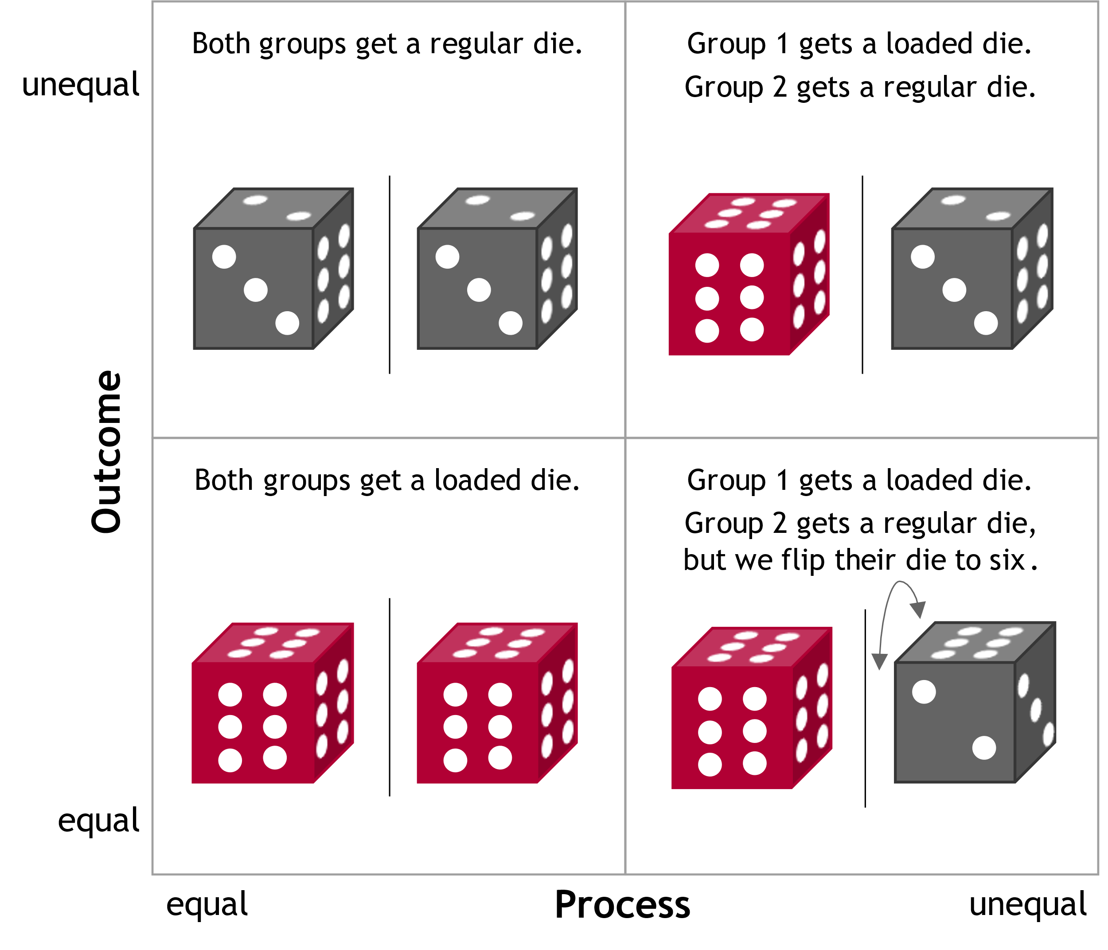
All the discussed fairness notions can be found in real applications. And algorithms can implement them.
Setting: Winners are accepted for university.
Rules 1 and 2: all people are equal
Rule 1: Trivial equal distribution, no AI necessary
Example: Everyone is accepted, e.g., online courses
Problem: limited resources, what about elite universities?
Rule 2: Brute luck, equal opportunities, no AI necessary
Example: lottery procedure for limited courses
Problem: arbitrary, unpredictable, undeserved?
Rules 3 and 4: some people are privileged (red = academic households)
Rule 3: Mitigating inequalities, AI optimized for “fairness”
Example: Quota regulations for (historically) marginalized groups
Problem: Which groups deserve preferential treatment? And why?
Rule 4: Rewarding inequalities ("merit principle"), AI optimized for accuracy
Example: Elite universities that only look at grades
Problem: Reinforcement of historical inequalities, lack of social mobility
Equal opportunity?
Discrimination?
Equal outcome?
Affirmative Action?
Disposition

Slide 3
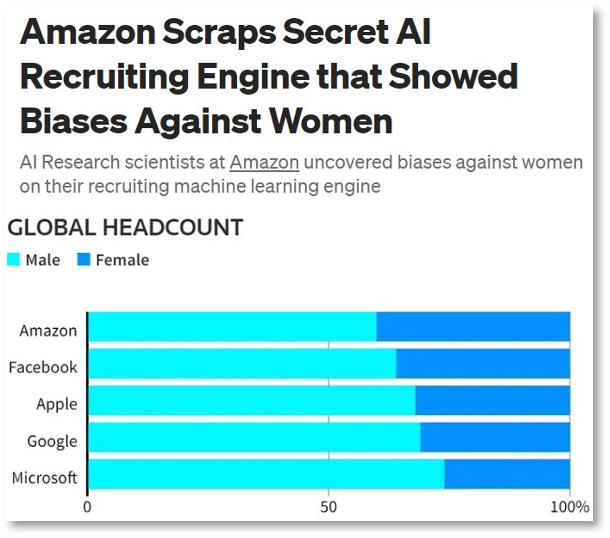
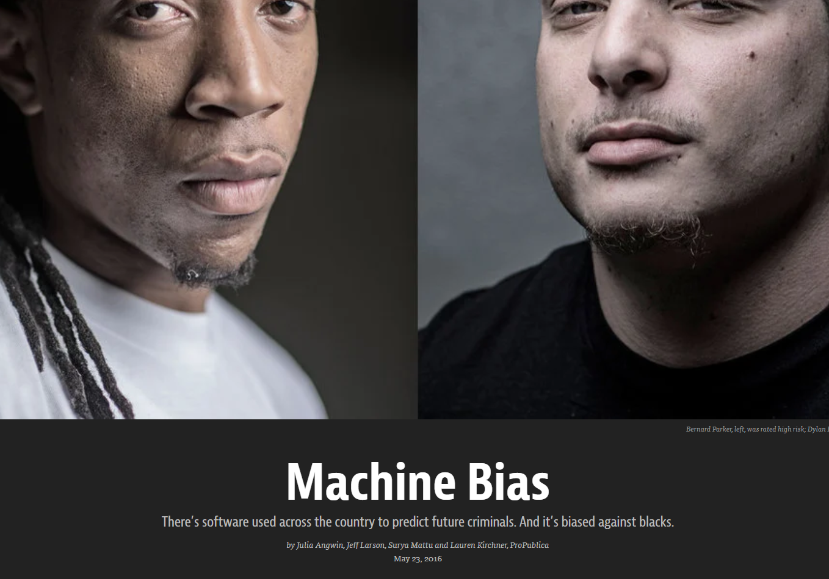



If we train ML models on past data without intervention, we will no longer be living in the future, but in the past
https://medium.datadriveninvestor.com/amazon-scraps-secret-ai-recruiting-engine-that-showed-biases-against-women-995c505f5c6f
https://www.propublica.org/article/machine-bias-risk-assessments-in-criminal-sentencing
“We have higher qualifications.”
“We have higher crime rates.”
Learning historical patterns…
“Women are unqualified!”
Learning historical patterns and correlations…
“Black people are criminals!”
Historical patriarchy
Sexist recruiting tool
Marginalized districts
Racist risk prediction

Slide 4
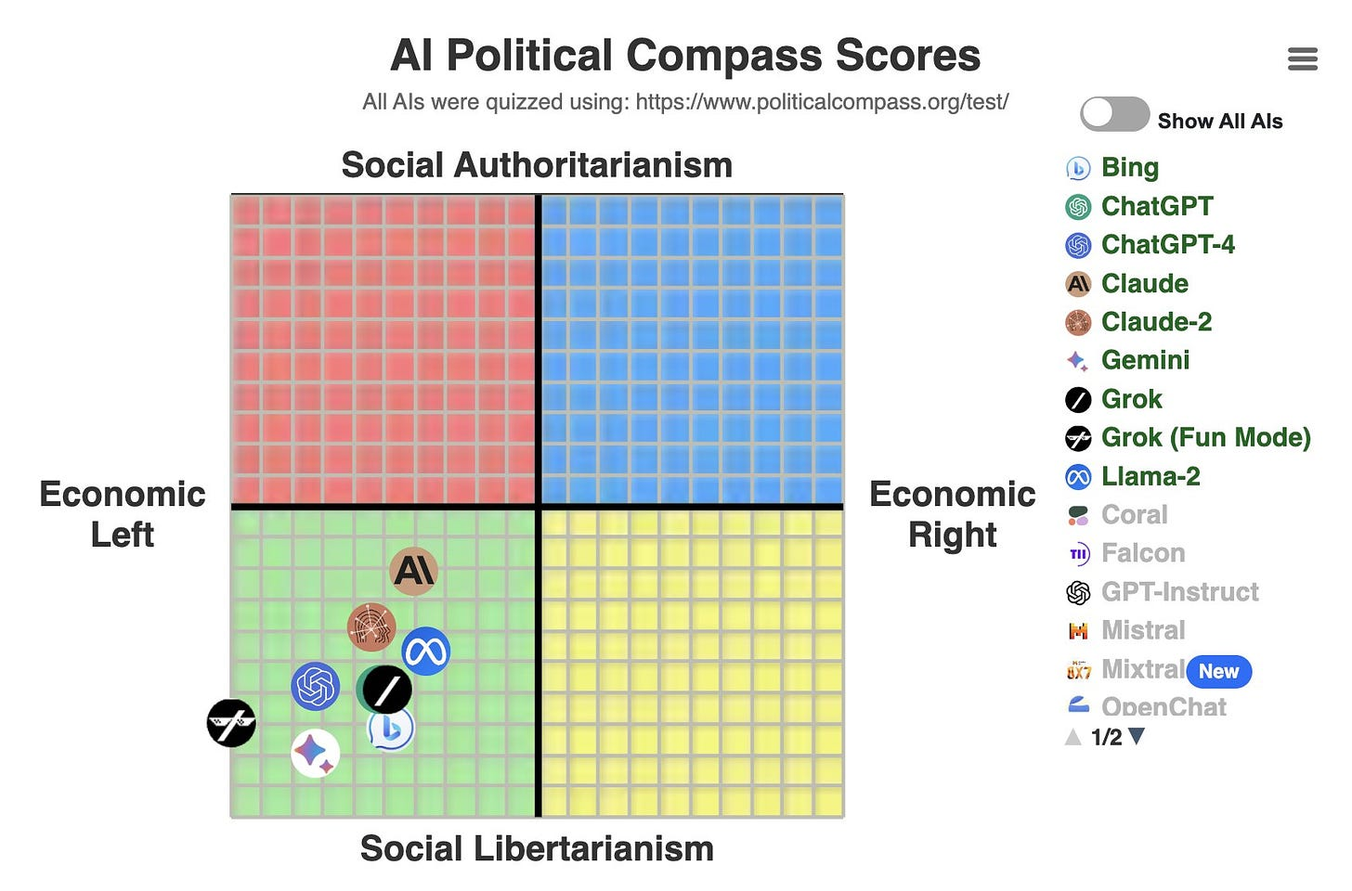
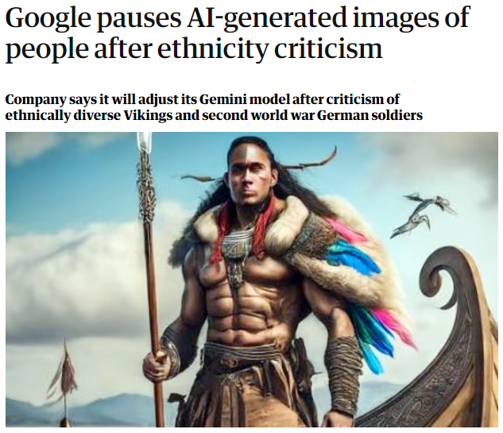
If we embed values in AI, which should it be? Who is to say?
Should developers implement their own world views?
What if fairness interventions overshoot the mark?
https://trackingai.org/
https://www.theguardian.com/technology/2024/feb/22/google-pauses-ai-generated-images-of-people-after-ethnicity-criticism

Slide 5








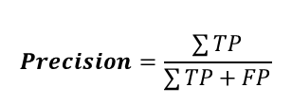
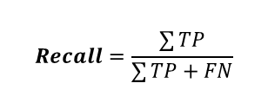
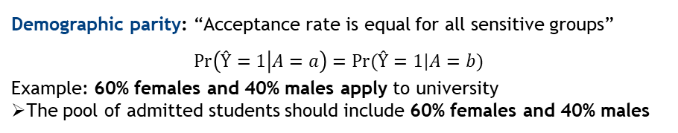
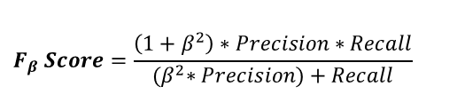
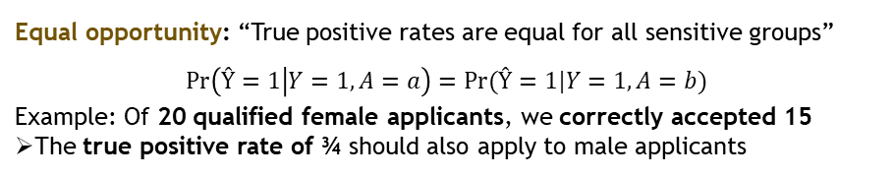
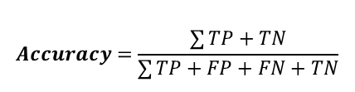
Classification, confusion matrix, and fairness metrics
Ground Truth Y
 | Positive | Negative
Positive | True Positive (TP) | False Positive (FP)
Negative | False Negative (FN) | True Negative (TN)
$$Precision=\frac{\sum{TP}}{\sum{TP}+FP}$$
$$Accuracy=\frac{\sum{TP+TN}}{\sum{TP}+FP+FN+TN}$$
Predictions Ŷ
$$Recall=\frac{\sum{TP}}{\sum{TP}+FN}$$
$$F_{β} Score=\frac{\left(1+β^{2}\right)∗Precision∗Recall}{{(β}^{2}∗Precision)+Recall}$$
Demographic parity: “Acceptance rate is equal for all sensitive groups”
$$\operatorname{Pr}\left(Ŷ=1 | A=a\right)=Pr⁡(Ŷ=1|A=b)$$
Example: 60% females and 40% males apply to university
The pool of admitted students should include 60% females and 40% males
Equal opportunity: “True positive rates are equal for all sensitive groups”
$$\operatorname{Pr}\left(Ŷ=1 | Y=1,A=a\right)=Pr⁡(Ŷ=1|Y=1,A=b)$$
Example: Of 20 qualified female applicants, we correctly accepted 15
The true positive rate of ¾ should also apply to male applicants
Pool of applicants
Pool of qualified applicants

Slide 6



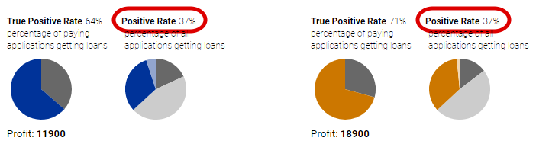
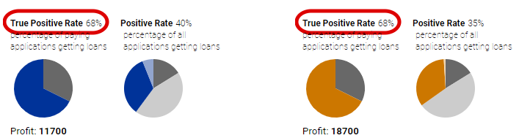

How do we choose the right formalized fairness metric?
Statistical Parity
Equal Opportunity
Pool of applicants
Pool of qualified applicants
Try it out yourself!
https://research.google.com/bigpicture/attacking-discrimination-in-ml/

Slide 7
How to get started with fairness in AI
Popular literature & movies
Cathy O’Neil. Weapons of Math Destruction​
Shalini Kantayya. Coded Bias (available on Netflix)
Interactive material
https://research.google.com/bigpicture/attacking-discrimination-in-ml/
https://fairlearn.org/
Academic literature
Dwork, Cynthia et al. (2012): Fairness through awareness.​
Barocas, Solon, Moritz Hardt, and Arvind Narayanan (2019): Fairness and machine learning. URL: http://www.fairmlbook.org​
Arif Khan, Falaah, Manis, Eleni, and Stoyanovich, Julia (2022): Towards Substantive Conceptions of Algorithmic Fairness: Normative Guidance from Equal Opportunity Doctrines

